Slide 1
Rigid Image Registration
Krupa Bhayani

Slide 2
Image Registration
Image registration is defined as a process that overlays two or more images from various imaging equipment or sensors taken at different times and angles, or from the same scene to geometrically align the images for analysis.
One of the images is used as reference to the geometric transformation that is applied in the other images (source images) so that they finally align with the reference image. Images which represent the same anatomical areas may be misaligned as they are captured by different imaging modalities, i.e., IVUS and micro-CT may represent the same coronary segment with different geometrical scaling.

Slide 3
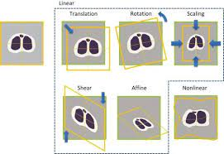
Image Registration
Image registration can be classified into several categories based on the transformation model that they use: rigid, affine, projective, and nonrigid transformations.
The complexity of the transforms in each transformation are characterized by the degrees of freedom. An object can be transformed using translation, rotation, and scaling.

Slide 4
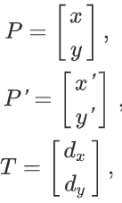
Translation
In two dimensions (2D), the point P(x,y) of an image is translated to new point P’(x,y) by adding the translation amounts d_{x} and d_{y} to the coordinates of the initial points x′ and y′:
x’ = d_{x} + x and y’ = d_{y} + y.
Their relation is, P’ = T + P.
Note: For 2D, there are 2 degrees of freedom for translation.

Slide 5

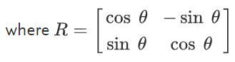
Rotation
The point P (x,y) of an image can be rotated around the origin by an angle θ as:
The relationship of scaling the point P′(x,y) to a new point P′(x,y′) in column vectors is:
P’ = R P

Slide 6



Scaling
All the points of an image can be scaled along the x and y axis by multiplying by s_{x} and s_{y}, respectively:
The relationship of scaling the point P′(x,y′) to a new point P′(x,y′) in column vectors is:
where S =

Slide 7

Rigid Transformation
A rigid-body transformation is composed of rotations and translations. It does not alter the shapes or sizes of the objects present in the image and is therefore used to model different head positions of the same subject.
Rigid transformations in 3D will have 6 degrees of freedom (3 rotational and 3 translational)
The rigid transformation can be defined in homogeneous coordinates as:
where R and T are as defined in the previous slides.

Slide 8
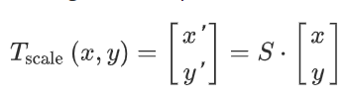
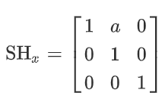
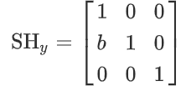
Affine Transformation
When translation and rotation is not enough, scaling is necessary to correct rigid transformation and is called affine transformation. This scaling can be expressed as:
where S is as defined in the previous slides.
The shear transformation is also an affine transformation. Two-dimensional shear transformation can be performed along the x axis and along the y axis as shown below with a and b as proportionality constants:

Slide 9
How do we apply the transformation to get an aligned image?
First of all we need to change voxel coordinates to physical coordinates.
Once in the physical space we can apply the geometric transformation to align the moving image to the fixed image.
The final goal is to have the moving image aligned to the fixed image in the space of the fixed image, so we have to take into account the mapping of the voxel intensities or features.

Slide 10
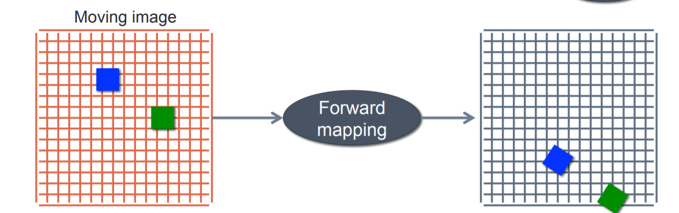
Forward mapping
Moving image voxels are mapped onto the fixed image

Slide 11
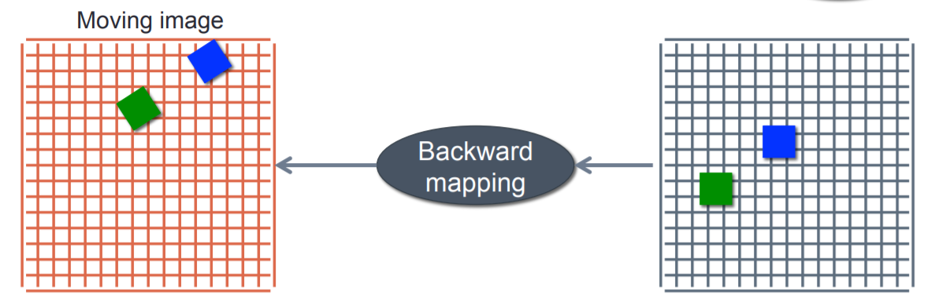
Backward mapping
Fixed image coordinates are mapped back onto the moving image

Slide 12
Intensity interpolation
Nearest neighbor
Linear
Spline

Slide 13
Optimizer
The optimizer helps us to find the optimal set of transformation parameters. eg: Gradient Descent.
The parameters of the transformation are thus those that map each voxel position in the fixed image to the moving image.

Slide 14
Algorithms for transformation
Surface Methods: Surfaces or boundaries or contours are generally distinct in medical images unlike landmarks.
eg: Heat and Hat algorithm, Iterative Closest Point Algorithm and Correspondence Matching Algorithm are successfully applied as registration algorithms for surface-based techniques.

Slide 15
Algorithms for transformation
Feature based methods: Feature-based methods establish a correspondence between a number of especially distinct points in images. Knowing the correspondence between a number of points in images, a geometrical transformation is then determined to map the target image to the reference images, thereby establishing point-by-point correspondence between the reference and target images.
eg: weighted geometric feature
Intensity-based methods: Intensity-based methods compare intensity patterns in images via correlation metrics. Intensity-based methods register entire images or sub-images.

Slide 16
Algorithms for transformation
Another classification can be made between single-modality and multi-modality methods. Single-modality methods tend to register images in the same modality acquired by the same scanner/sensor type, while multi-modality registration methods tended to register images acquired by different scanner/sensor types.
Multi-modality registration methods are often used in medical imaging as images of a subject are frequently obtained from different scanners. Examples include registration of brain CT/MRI images or whole body PET/CT images for tumor localization, registration of contrast-enhanced CT images against non-contrast-enhanced CT images for segmentation of specific parts of the anatomy, and registration of ultrasound and CT images for prostate localization in radiotherapy.

Slide 17
Relevant Papers
Lifeng Shang, Jian Cheng Lv, Zhang Yi, “Rigid medical image registration using PCA neural network”, Neurocomputing 69 (2006), 1717–1722.
C. Dorai, G. Wang, A.K. Jain, C. Mercer, “Registration and integration of multiple object views for 3D model construction”, IEEE Trans. Pattern Anal. Machine Intelligence. 20 (1),(1998), 83–89.
T. Masuda, K. Sakaue, N. Yokoya, “Registration and integration of multiple range images for 3-D model construction”, Proceedings of the 13th International Conference on Pattern Recognition, Vol. 1, 1996, 879–883.
P.J. Besl, N.D. McKay, “A method for registration of 3-D shapes”, IEEE Trans. Pattern Analysis Machine Intelligence 14 (2) (1992), 239–256.

Slide 18
Relevant Papers
G. Blais, M.D. Levine, “Registering multiview range data to create 3D computer objects”, IEEE Trans. Pattern Analysis and .Machine Intelligence 17 (8) (1995) 820–824.
T. Masuda, N. Yokoya, “A robust method for registration and segmentation of multiple range images”, Proceedings of the Second Workshop on CAD-Based Vision, 1994, 106–113.
S.M. Yamany, A.A. Farag, “Free-form surface registration using surface signatures” Proceedings of the Seventh IEEE International Conference on Computer Vision, Vol. 2, 1999, 1098–1104.
C. Schutz, T. Jost, H. Hugli, “Multi-feature matching algorithm for free-form 3D surface registration”, Proceedings of the 14th International Conference on Pattern Recognition, Vol. 2, 1998, 982–984.

Slide 19
Relevant Papers
A.E. Johnson, M. Hebert, “Surface registration by matching oriented points”, Proceedings of the International Conference on Recent Advances in 3-D Digital Imaging and Modeling, 1997, 121–128.
W.R. Fright, A.D. Linney, “Registration of3-D head surfaces using multiple landmarks”, IEEE Trans. on Medical Imaging 12 (3) (1993), 515–520.
Chi Kin Chow, Hung Tat Tsui, Tong Lee, “Surface registration using a dynamic genetic algorithm”, Pattern Recognition 37, (2004), 105-117

Slide 20
Libraries/ Toolkits for Rigid and Affine Transformations.
https://pypi.org/project/lcreg/
https://pypi.org/project/imgreg2D/
https://image-registration.readthedocs.io/en/latest/

Slide 21
Non Rigid
https://pypi.org/project/itk-registration/
http://pyimreg.github.io/
https://pypi.org/project/pystackreg/

Slide 22
References
https://www.youtube.com/watch?v=5FEr5SiXB1g&ab_channel=DigitalSreeni
https://cind.ucsf.edu/sites/cind.ucsf.edu/files/wysiwyg/education/RigidRegistration.pdf
https://www.sciencedirect.com/topics/medicine-and-dentistry/rigid-image-registration
https://arxiv.org/ftp/arxiv/papers/1712/1712.07540.pdf
http://www.sci.utah.edu/~gerig/CS6640-F2010/p325-brown.pdf
https://www.geeksforgeeks.org/image-registration-using-opencv-python/
https://docs.opencv.org/master/db/d61/group__reg.html
https://en.wikipedia.org/wiki/Image_registration

